Slide 1
The Walmart Sales Analysis
By
Anshu raina
Gopalakrishnan Kailasanathan
Sarath joseph
Sneha chitturi

Slide 2
INTRODUCTION
Walmart is one of the biggest retail stores in the U.S.
They have various markdown events which have a great impact on their sales.
Our goal is to predict weekly sales for stores and departments in the Walmart for the year 2013.
Using the historical data, We have to predict which departments would be affected and the extent of the impact on weekly sales.

Slide 3
DATA EXPLORATION
We got the following data sets from KAGGLE website
1. Features.csv
2. Store.csv
3. train.csv
4. test.csv
Features data set contains external features affecting the weekly sales such as markdowns,CPI,temperature,fuel price,unemployement and Isholiday.
Store contains the store and respective department information.
Train data set contains historical information from 05/02/2010 to 01/11/2012.
Test data set is the input file given to model to have predicted weekly sales for year 2013.

Slide 4
DATA PREPROCESSING
we need features in our train data set as they have a great impact on the weekly sales.
We merged the two data sets based on store number and date. This helps us in analyzing the weekly sales with respect to other factors that impact the sales. We used VLookup function in Excel to merge the two files.
We also have missing values in markdowns. We used “replace missing values” filter in WEKA to replace all the missing values with modes and means from the training data set.
The date attribute is recognized as nominal by WEKA. So, we converted it to date type.

Slide 5
MINING THE DATA
We used regression technique to predict weekly sales for Stores 3,5,14, 18,20 and departments 11,12,13,92 based on highest –lowest weekly sales from train data set.
Data mining techniques used:
a. Linear regression under classification tab.
Relative absolute error was 99%
b.1. Linear regression under forecast tab.
b.2. SMOreg under forecast tab.
On comparison SMOreg gave closer prediction.

Slide 6
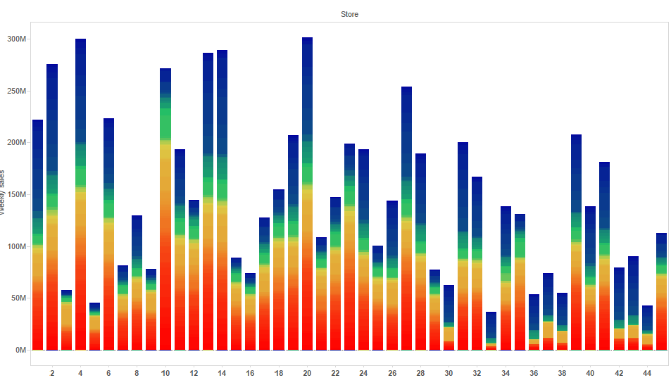
Data Analysis

Slide 7
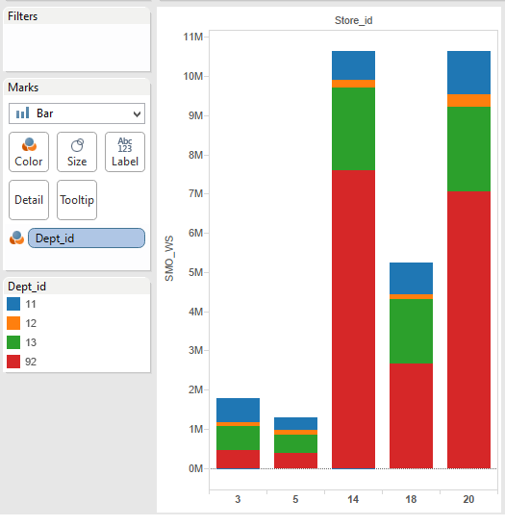
Data Analysis

Slide 8
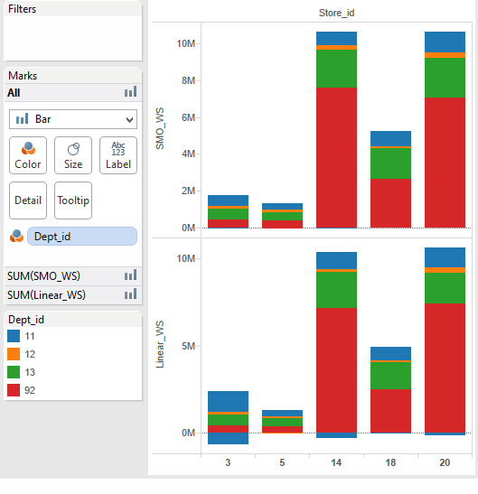
MODEL PERFORMANCE

Slide 9
Model Performance
Store | Linear MAE | SMOreg MAE
3 | 13037.41436 | 3835.709204
5 | 1512.015854 | 1095.24153
14 | 12954.22138 | 10337.50745
18 | 4818.274806 | 4407.581072
20 | 12557.98397 | 5991.152678

Slide 10
LOGIC OF PROBLEM
Checkpoint 1:
We understood and established the information and data that we needed to work for this project in all the elements of the logic of problem.
The analytical thinking tool helped us to discover all the 8 elements embedded in our project.
Checkpoint 2:
We have updated most of the elements in the logic of problem keeping in mind about data exploration phase.
We analyzed that we have missing values and correlation between attributes.

Slide 11
Contd..
Checkpoint 3:
Continuing with preprocessing steps and algorithm selection process, we updated the information and concept steps in the logic of problem.
After comparing different regression algorithms we found SMOreg best fits to our data.

Slide 12
Advantages of “Logic of problem”
The tool gave us an idea on how to think analytically for a problem.
Eight elements help in understanding the core concepts and the ideology behind the project.
It gives the analyst a disciplinary approach in converging on a solution to a problem.
This tool helped us to understand the emphasis of particular elements at each phase of the project.

Slide 13
Disadvantages
Each phase of project required constant update in all the elements of the tool.
There is no way to navigate to previous updates done.
The user interface is not friendly on navigating to a particular element, it doesn’t stay there.

Slide 14
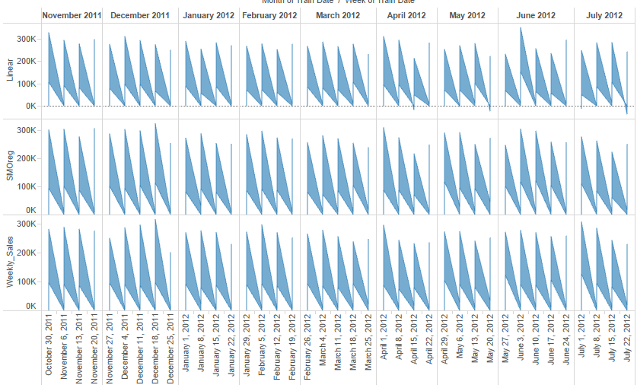
Conclusion

Slide 15
CONCLUSION
After analyzing the results through graph, linear predicts lots of negative values when compared with SMOreg.
SMOreg gave closer prediction for selected stores and departments.
Linear gave huge variations in predicted weekly sales.

Slide 16
References
Retrieved from • www.kaggle.com/c/walmart-recruiting-store-sales-forecasting
Ezekiel, M., & Fox, K. A. (1959). Methods of Correlation and Regression Analysis. London: John Wiley & Sons.
Murray, D. (2013). Tableau Your Data!: Fast and Easy Visual Analysis with Tableau Software. Hoboken: Wiley.
Provost, F., & Fawcett, T. (2013). Data science for business: [what you need to know about data mining and data-analytic thinking]. Sebastopol, Calif: O'Reilly.

